Slide 1

Responsive CSS
Full stack

Slide 2

Responsive design
This Photo by Unknown Author is licensed under CC BY

Slide 3

To make web pages responsive we use “break poitns”
@media only screen and (max-width: 600px) { body { background-color: lightblue; } }

Slide 4
Make “breaking points” in order
@media only screen and (max-width: 1200px) { body { background-color: lightblue; } }
@media only screen and (max-width: 800px) { body { background-color: green; } }
@media only screen and (max-width: 600px) { body { background-color: red; } }

Slide 5
Different “breaking points” for screens
/* Extra small devices (phones, 600px and down) */ @media only screen and (max-width: 600px) {...} /* Small devices (portrait tablets and large phones, 600px and up) */ @media only screen and (max-width: 768px) {...} /* Medium devices (landscape tablets, 768px and up) */ @media only screen and (max-width: 992px) {...} /* Large devices (laptops/desktops, 992px and up) */ @media only screen and (max-width: 1200px) {...} /* Extra large devices (large laptops and desktops, 1200px and up) */ @media only screen and (min-width: 1200px) {...}

Slide 6

Examples

Slide 7

Advance layouts

Slide 8
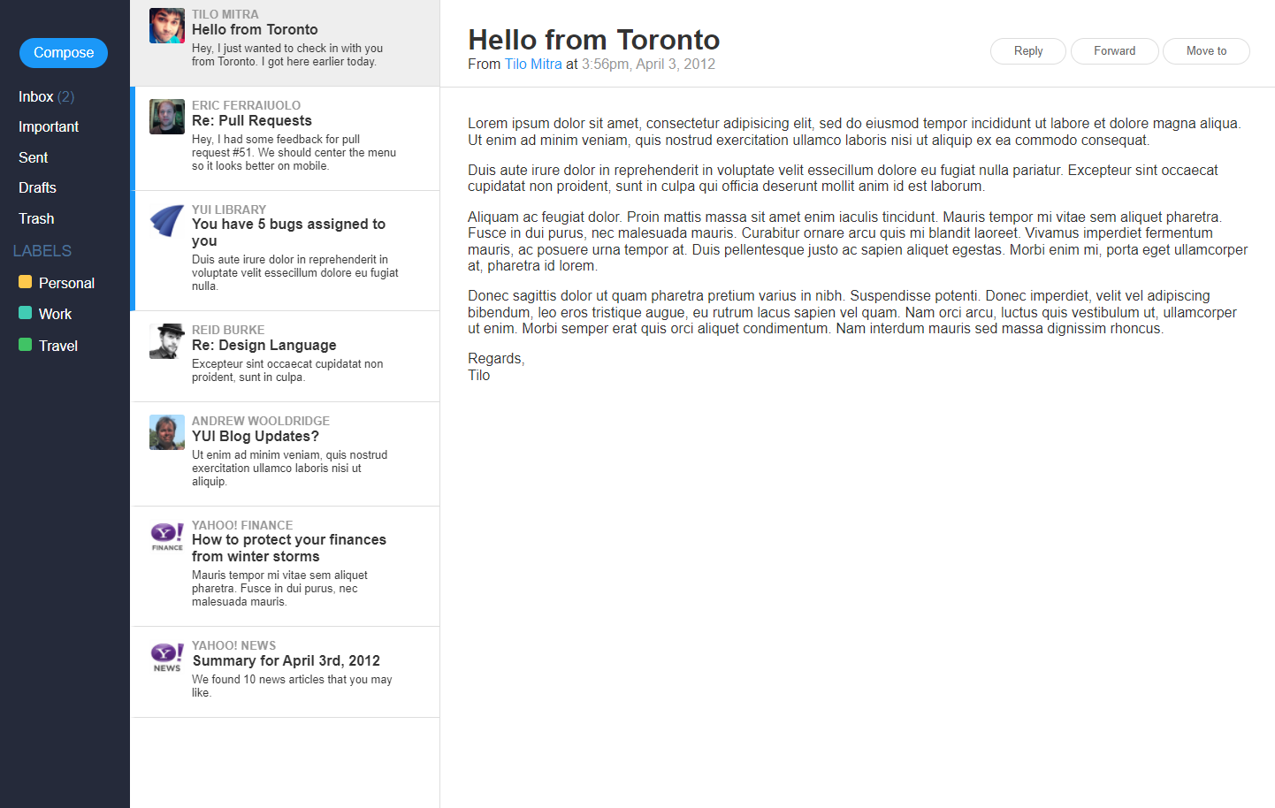

Slide 9
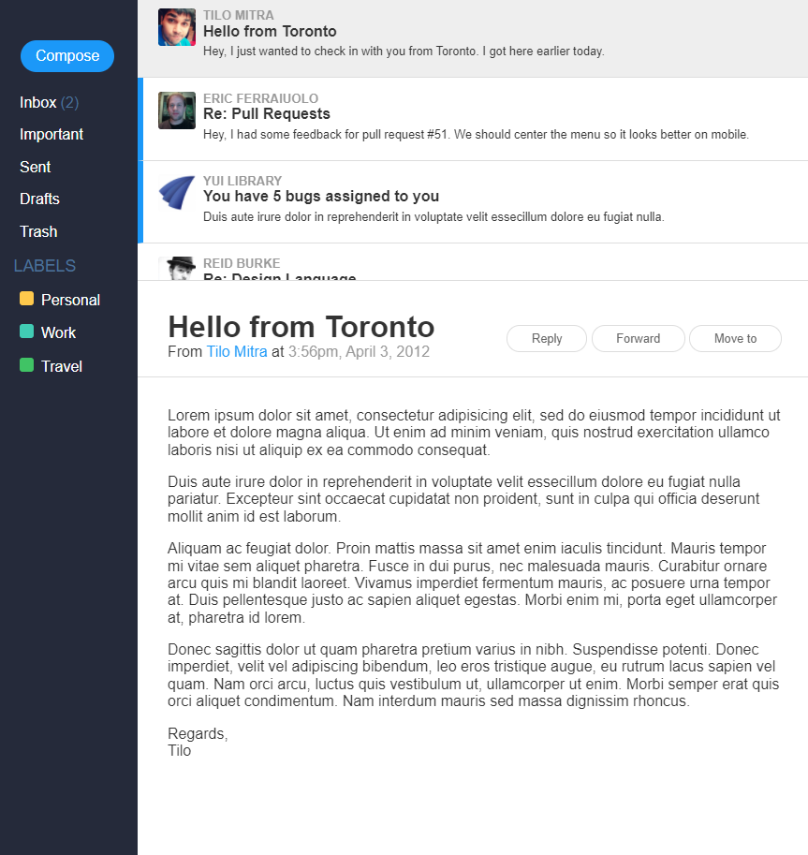

Slide 10
